Slide 1
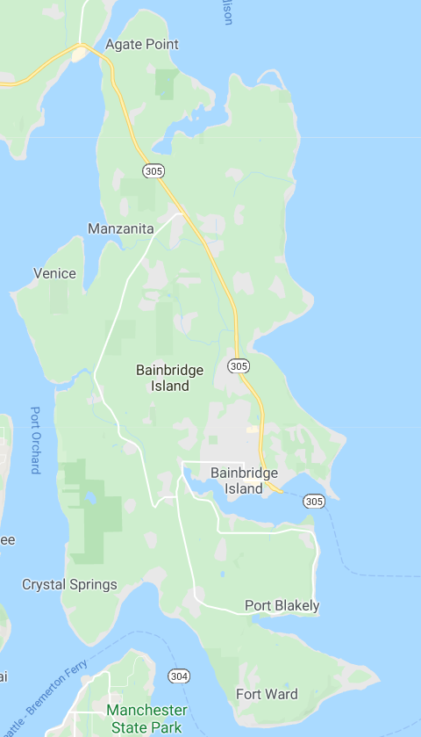
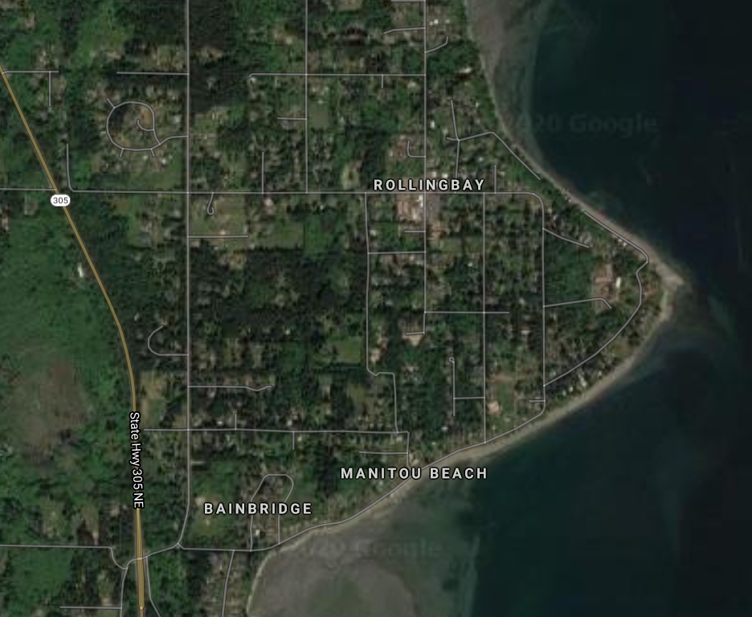
City of Bainbridge Island Countywide Project Proposal: Rolling Bay Bicycle and Pedestrian Improvements
Vicinity Map 1
Vicinity Map 2
PSRC Criteria:
City Criteria/Notes:
Cost:
Supports local centers
Funding feasibility
Cross juris. opportunities
Safety/capacity
Health equity
Air quality
Multimodal
Identified in IWTP
Emphasizes traffic calming
Innovative approach
Complete street approach
Urban/rural context sensitive
Relative high volume of usage
ROW:
$50,000 Local Funds
Preliminary Engineering:
$54,000 Local Funds
$346,000 Federal Funds
Construction:
$170,000 Local Funds
$1,080,000 Federal Funds
Total Cost: $1,700,000
Vicinity Map 3
Visually separated bicycle lane (both sides); retaining walls and drainage
Inset
Madison Ave.
Valley Road
Inset Map
N
Sunrise Drive
ADA sidewalks and driveway crossings; formalized parking; stormwater facilities
Valley Road
Traffic circle; ADA sidewalks and ramps
Bicycle lane; ADA sidewalks and driveway crossings

Slide 2
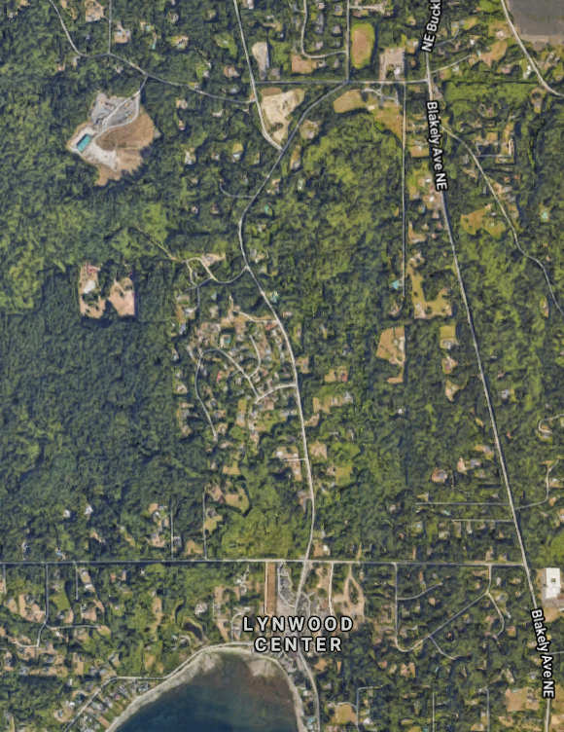
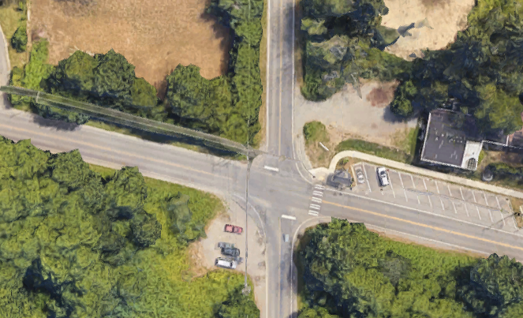
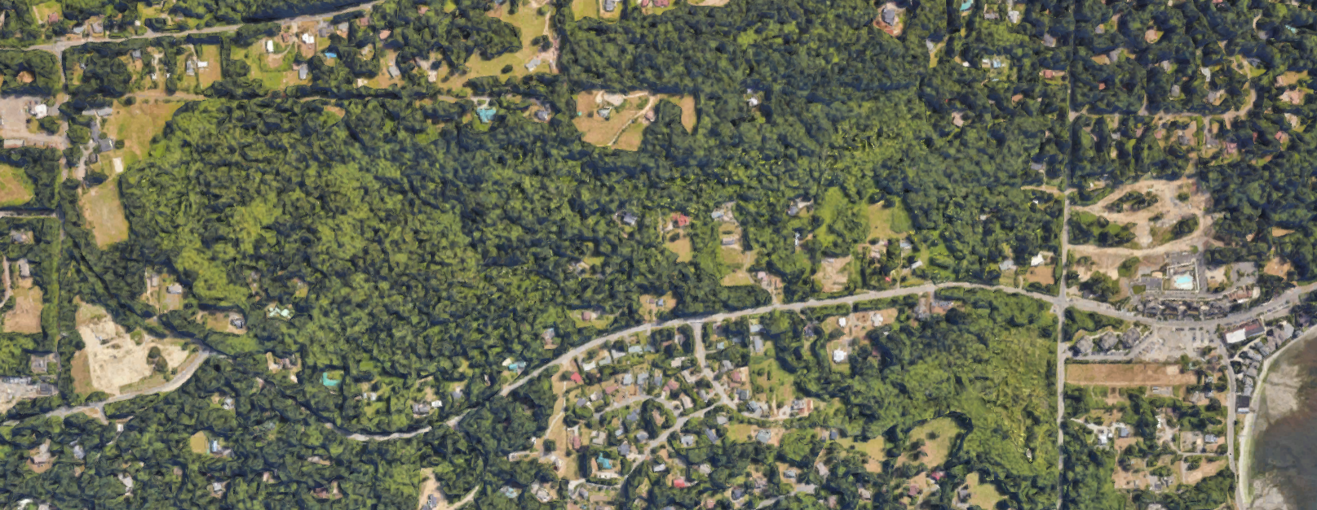
City of Bainbridge Island Countywide Project Proposal: Blakely to Lynwood Bicycle and Pedestrian Improvements
Vicinity Map 1
Vicinity Map 2
PSRC Criteria:
City Criteria / Notes:
Cost:
Supports local centers
Funding feasibility
Cross juris. opportunities
Safety/capacity
Health equity
Air quality
Multimodal
Identified in IWTP and CIP
Emphasizes traffic calming
Innovative approach
Complete street approach
Urban/rural context sensitive
Relative high volume of usage
Addresses known safety issue
ROW:
$100,000 Local Funds (secured)
Preliminary Engineering:
$25,000 Local Funds (Secured)
$125,000 Federal Funds
Construction:
$160,000 Local Funds (Secured)
$1,025,000 Federal Funds
Total Cost: $1,435,000
Vicinity Map 3
Inset Map
Blakely Avenue
N
4-way stop or traffic circle/calming; ADA sidewalk ramps; bus stop improvements and covered bicycle storage
Paved bicycle lane shoulder – (both sides)
Baker Hill Road
Inset
Lynwood Center Road
Paved bicycle lane shoulder – southbound (one side)
Lynwood Center
Optional paved multi-use separated path

Slide 3
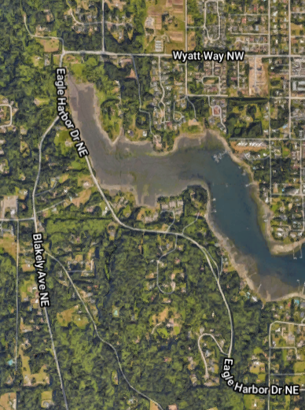
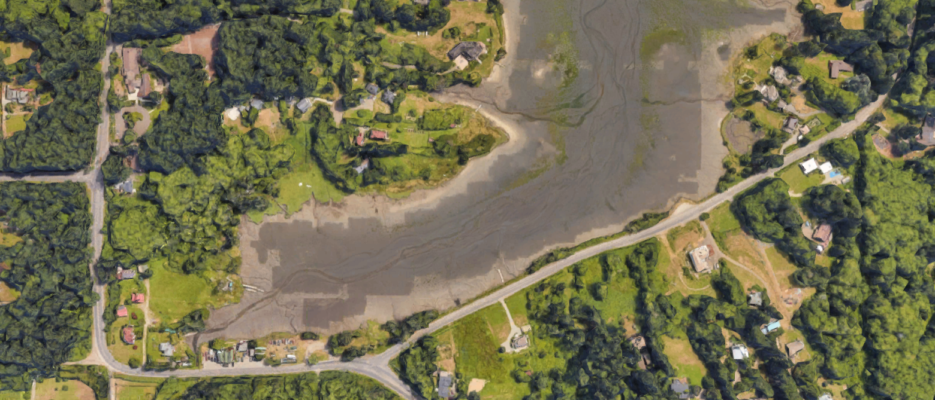
City of Bainbridge Island Countywide Project Proposal: Winslow to Eagledale Bicycle Improvements – Phase 1
Vicinity Map 1
Vicinity Map 2
PSRC Criteria:
City Criteria:
Cost:
Supports local centers
Funding feasibility
Cross juris. opportunities
Safety/capacity
Health equity
Air quality
Multimodal
Identified in IWTP and CIP
Relative high volume of usage
Addresses known safety issue
Phase 2 project has pending federal contingency funds
Includes fish passage culvert (state grant funds pending)
ROW:
$25,000 Local Funds
Preliminary Engineering:
$22,000 Local Funds (Secured)
$138,000 Federal Funds
Construction:
$140,000 Local Funds (Secured)
$900,000 Federal Funds
Total Cost: $1,200,000
Vicinity Map 3
N
Paved bicycle lane shoulder – both sides
Wyatt Way
End phase 1, begin phase 2 bicycle lane shoulder improvements – both sides
Fish passage culvert improvement (concrete box structure)
Eagle Harbor Drive

Slide 4
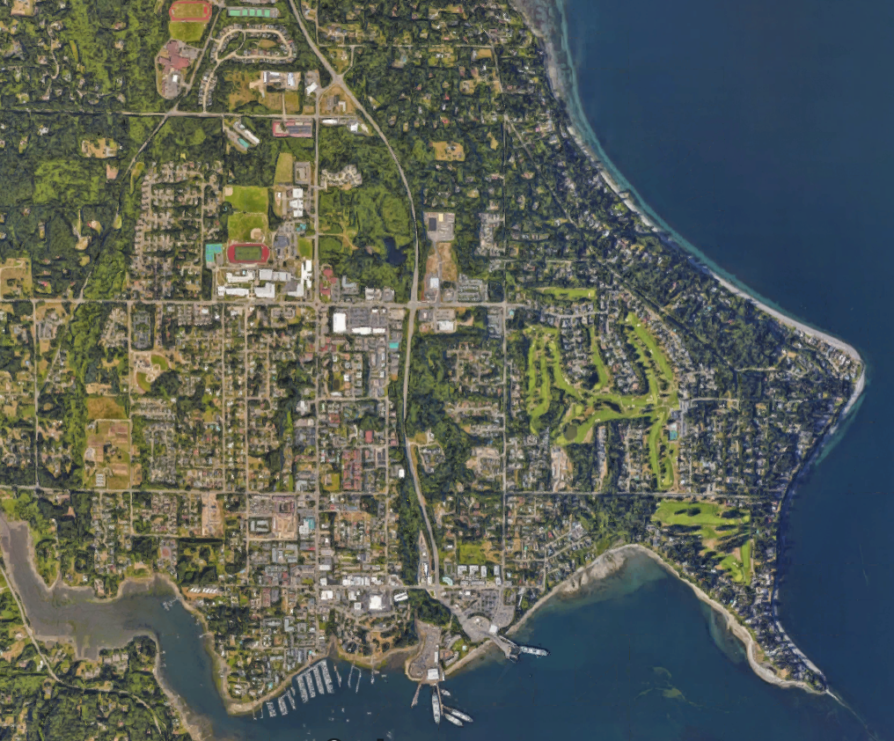
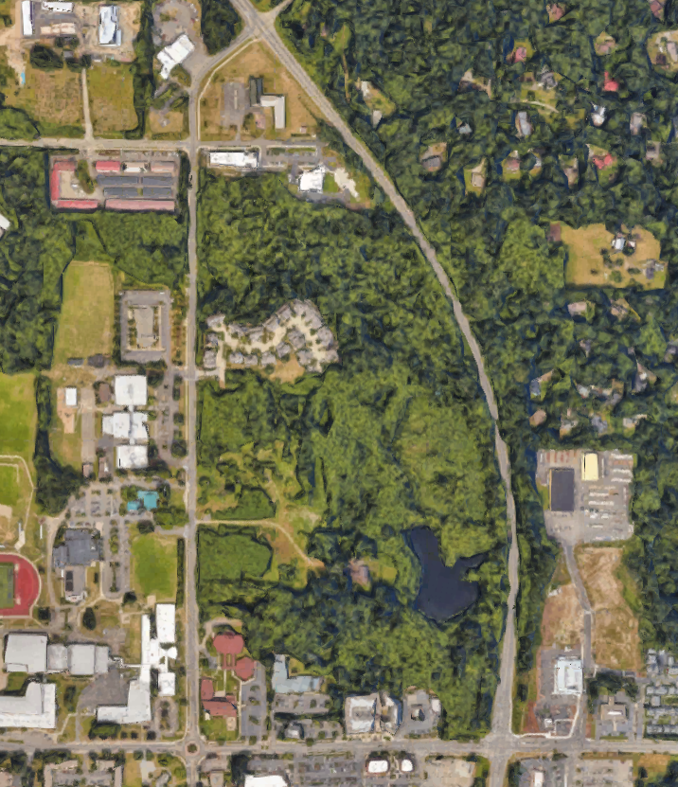
City of Bainbridge Island Regional Project Proposal: Sound to Olympics Trail Phase 4
Vicinity Map 1
Vicinity Map 2
Vicinity Map 3
City Criteria:
Cost / Notes:
Emphasizes traffic calming
Innovative approach
Complete street approach
Urban/rural context sensitive
Relative high volume of usage
N
New Brooklyn Road
10’-wide, separated, paved multi-use trail
PSRC Criteria:
City Criteria:
Supports local centers
Funding feasibility
Cross juris. opportunities
Safety/capacity
Health equity
Air quality
Multimodal
Identified in IWTP and Kitsap Regional Trails Plan
Relative high volume of usage
Portions of project outside of ROW entirely on BI Parks property
Supports local, commuter and regional usage
S.R. 305
Madison Avenue
Cost:
Preliminary Engineering:
$65,000 Local Funds
$385,000 Federal Funds
Construction:
$340,000 Local Funds
$2,160,000 Federal Funds
Total Cost: $2,950,000
End Sound to Olympics Trail phase 3 (existing and proposed) , begin phase 4 (northward)
High School Road

