Slide 1
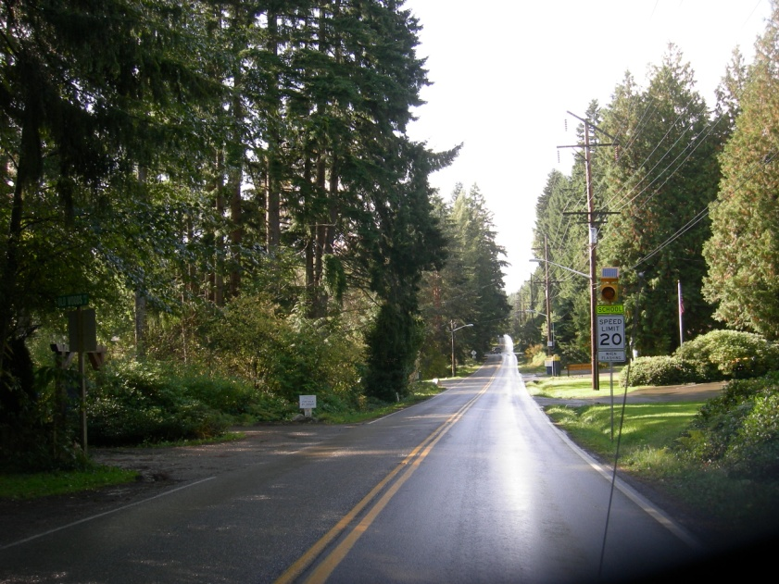
2018 STP County-wide Competition
Core 40 – Bucklin Hill Road Phase 2 Shoulder Improvements

Slide 2
Bucklin Hill Segment of C40 Network

Slide 3
Project Overview
Connection to Local Centers Winslow, Lynwood Center, and Island Center
Completes gap in Core 40 non-motorized system
Increases safety for non-motorized users
Increases non-motorized travel
Improve non-motorized connectivity between Local Centers Winslow, Island Center, and Lynwood Center with paved shoulders for bicyclists.

Slide 4
Project (Schedule) Readiness:
C40 Bucklin Hill Phase 2 Shoulder Improvements
Funding for ROW acquisition = $694K
STP $600K, City match $94K
In-house PE planned
Construction Funding to be requested in future funding cycle

