Slide 1
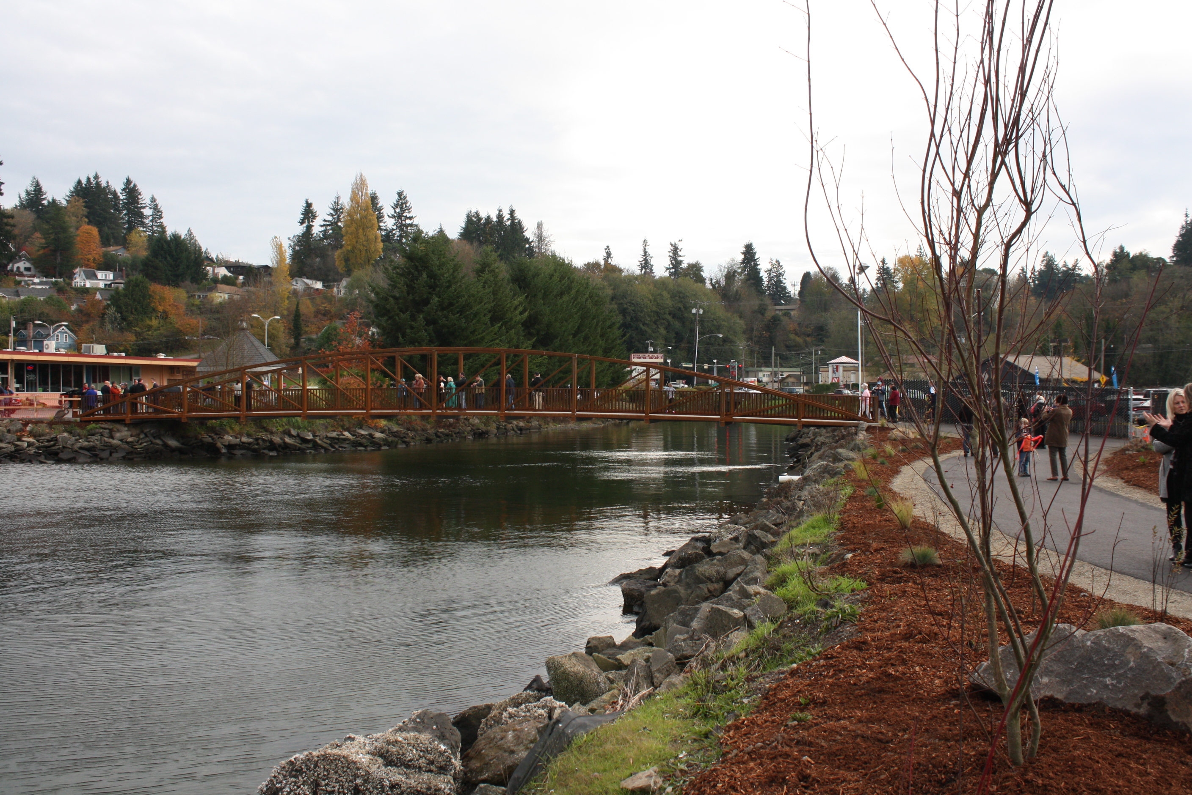
BAY STREET PEDESTRIAN PATHWAY WEST SITUATIONAL STUDY
Connecting the Kitsap Transit Downtown Foot Ferry Terminal to the Tremont Street Widening Project

Slide 2
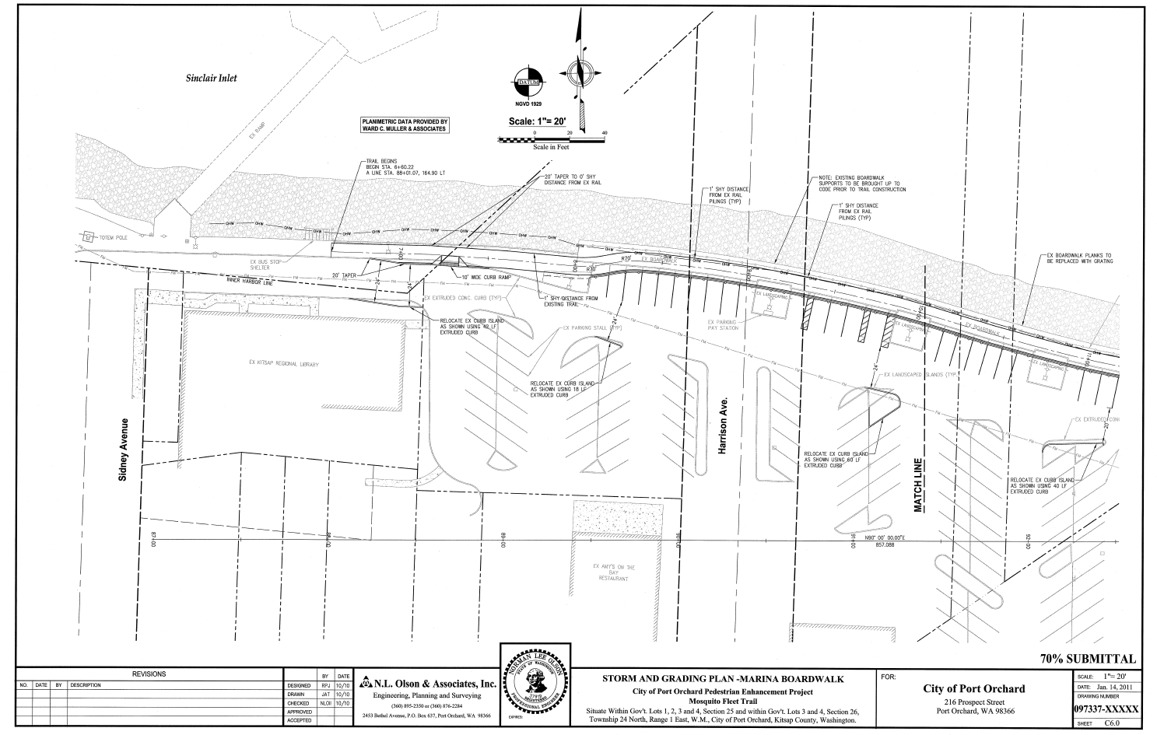
BAY STREET PEDESTRIAN PATHWAY PROJECT
Begin 14-ft Wide Multi-Modal Pathway at Kitsap Transit Downtown Foot Ferry Terminal, then West to Port Orchard Boulevard

Slide 3
Port Orchard Boulevard
Add Roundabout(s) at Both the North and the South End of Port Orchard Boulevard, and Reconstruct with 3-Lane Complete Street

Slide 4
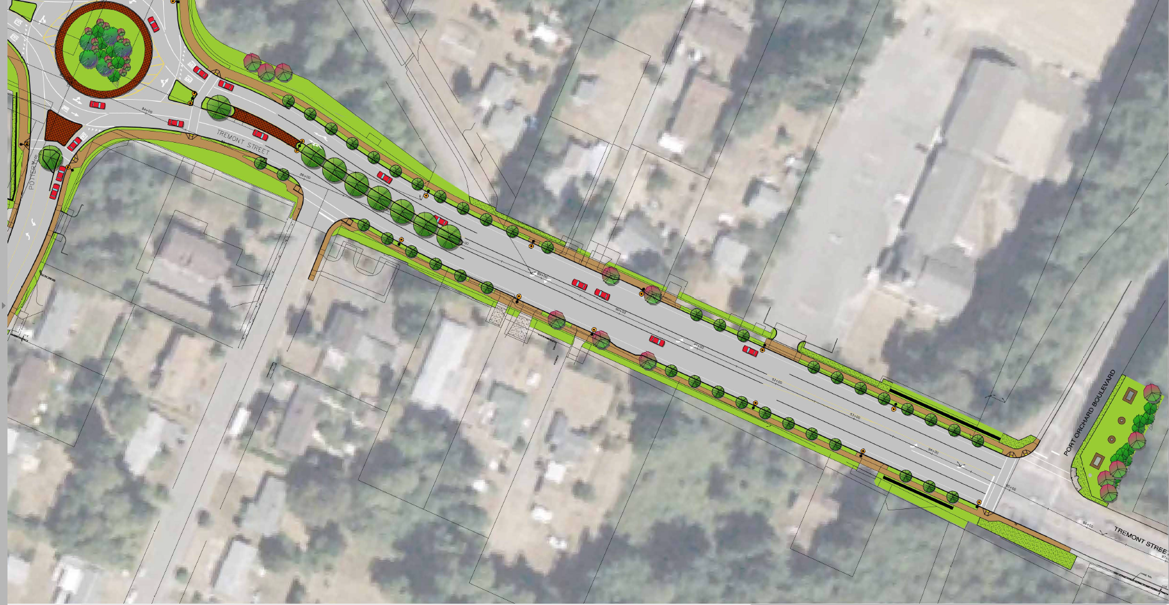
TREMONT STREET WIDENING PROJECT
End Complete Street at Inter-section of Tremont Street and Port Orchard Boulevard

Slide 5

QUESTIONS?

