Slide 1
CITY OF POULSB0 2018 Countywide Applications
Transpol presentation
April 19, 2018

Slide 2
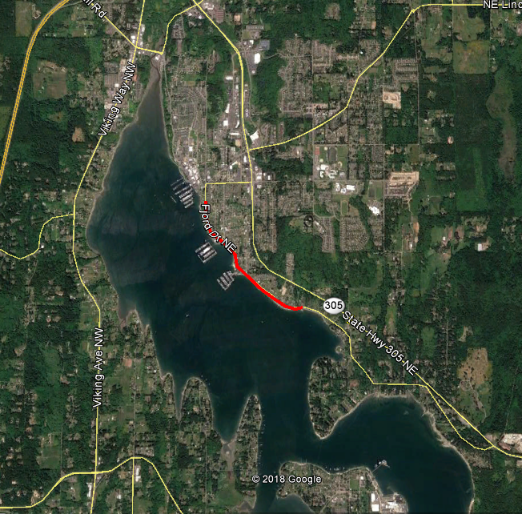
PROJECTS
SR305 Pedestrian Tunnel
Non-Motorized
Construction
$1.5M request, $1.8M total
Fjord Drive Pavement Preservation
Construction
$425k request, $490k total
Fjord Drive
Preservation
Pedestrian Tunnel

Slide 3
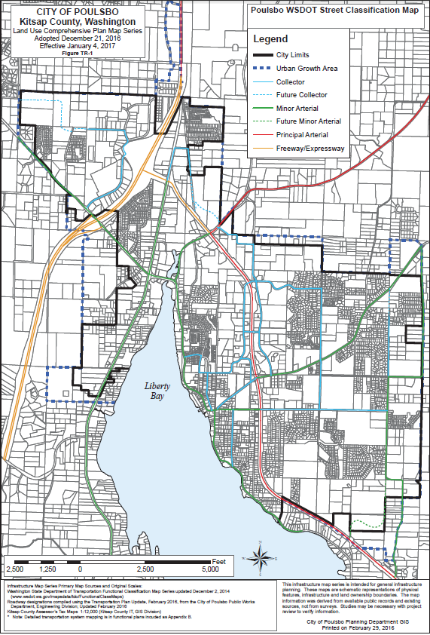
SR305 Pedestrian Tunnel
Non-Motorized element of City Noll Road Corridor project
Part of SR305 –Johnson Road RBT project
High Priority in SR305 Corridor Plan
Replaces dangerous pedestrian crossing and intersection
Noll Road Corridor
Pedestrian Tunnel and RBT at SR305
Existing Noll Road Approach to SR305

Slide 4
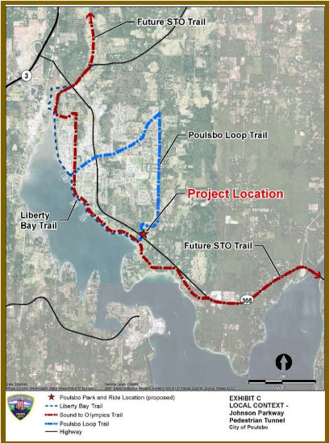
SR305 Pedestrian Tunnel
Connects regional non-motorized routes and segments
Serves NK region and City
Tunnel is safest option for crossing high volume/high speed SR305

Slide 5
SR305 Pedestrian Tunnel
Requesting $1.5M, total cost $1.8M
Construction

Slide 6
Fjord Drive Pavement Preservation
Harrison Street to City Limits
Major arterial street
Poor condition
$490k cost
$425k funding request
Construct 2021

Slide 7
Poulsbo 2018 Countywide Projects
QUESTIONS?

