Slide 1
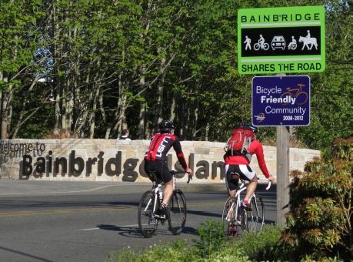
2018 STP County-wide Competition
Core 40 – Eagle Harbor Phase 2 Shoulder Improvements

Slide 2
Eagle Harbor Segment of C40 Network

Slide 3
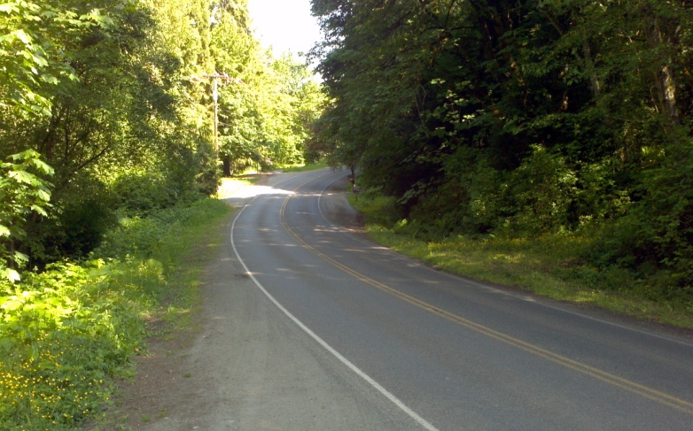
Project Overview
Connection to Local Centers Winslow, Lynwood Center, and Island Center
Completes gap in Core 40 non-motorized system
Increases safety for non-motorized users
Increases non-motorized travel
Improve non-motorized connectivity to Local Centers Winslow, Lynwood, and Island Center with paved shoulders for bicyclists.

Slide 4
Project (Schedule) Readiness:
C40 Eagle Harbor Phase 2 Shoulder Improvements
Project Cost = $810K for Construction in 2022
STP $700K, City match $110K
No ROW acquisition required
In-house PE planned

