Slide 1
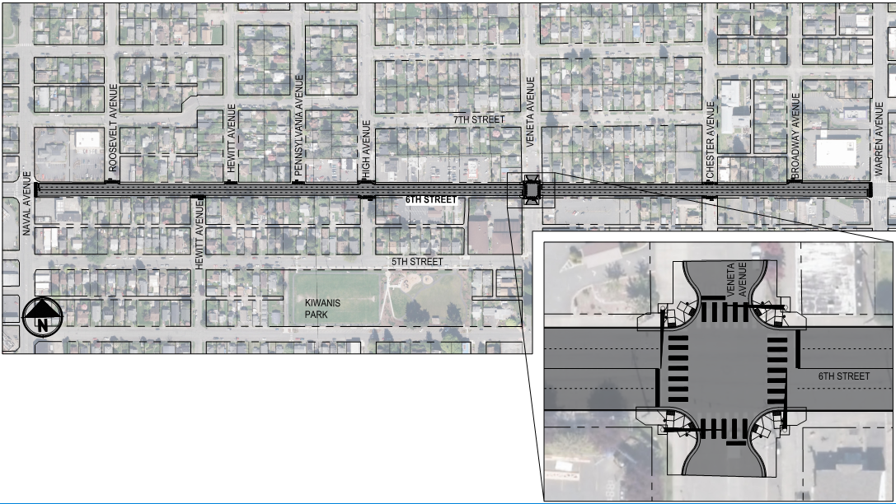
6th Street Preservation TransPOL; March 19, 2020

Slide 2
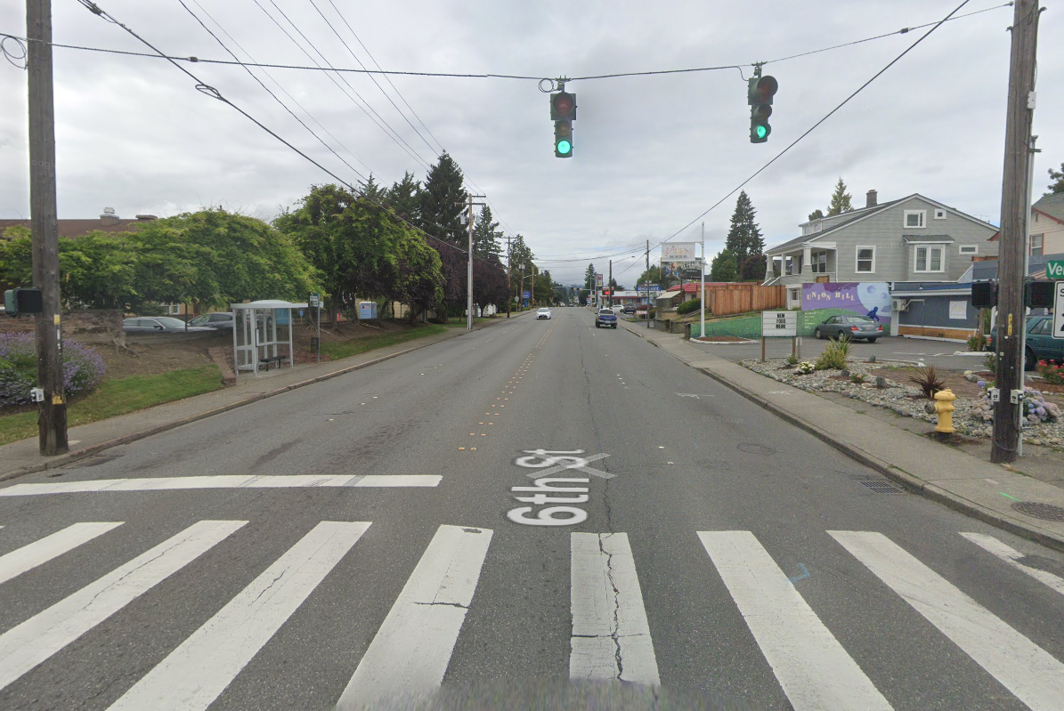
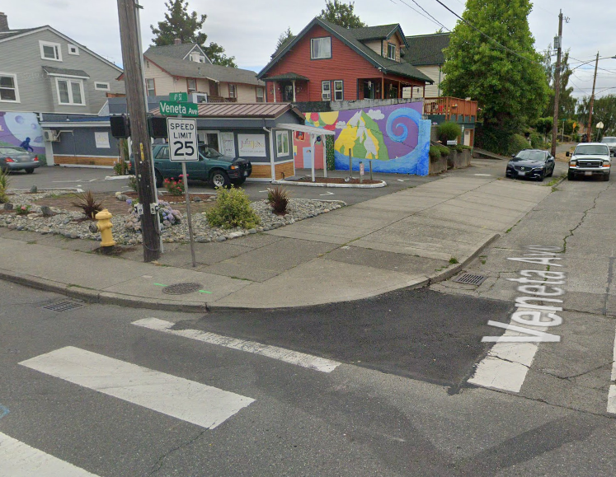
Scope, Schedule & Budget
Scope
Overlay 6th Street between Naval and Warren, 26 ADA ramps (Preservation, $1.37M; STP-General $210K)
Replace Traffic Signal at Veneta Ave (STP-General, $300K)
Span wire signal
Does not meet ADA standards
Countywide Request
Project cost = $2.17M
STP $1,877,050, match $292,950
Design & Construct 2023/2024

Slide 3
West Kitsap Way Corridor Planning Study TransPOL; March 19, 2020

Slide 4
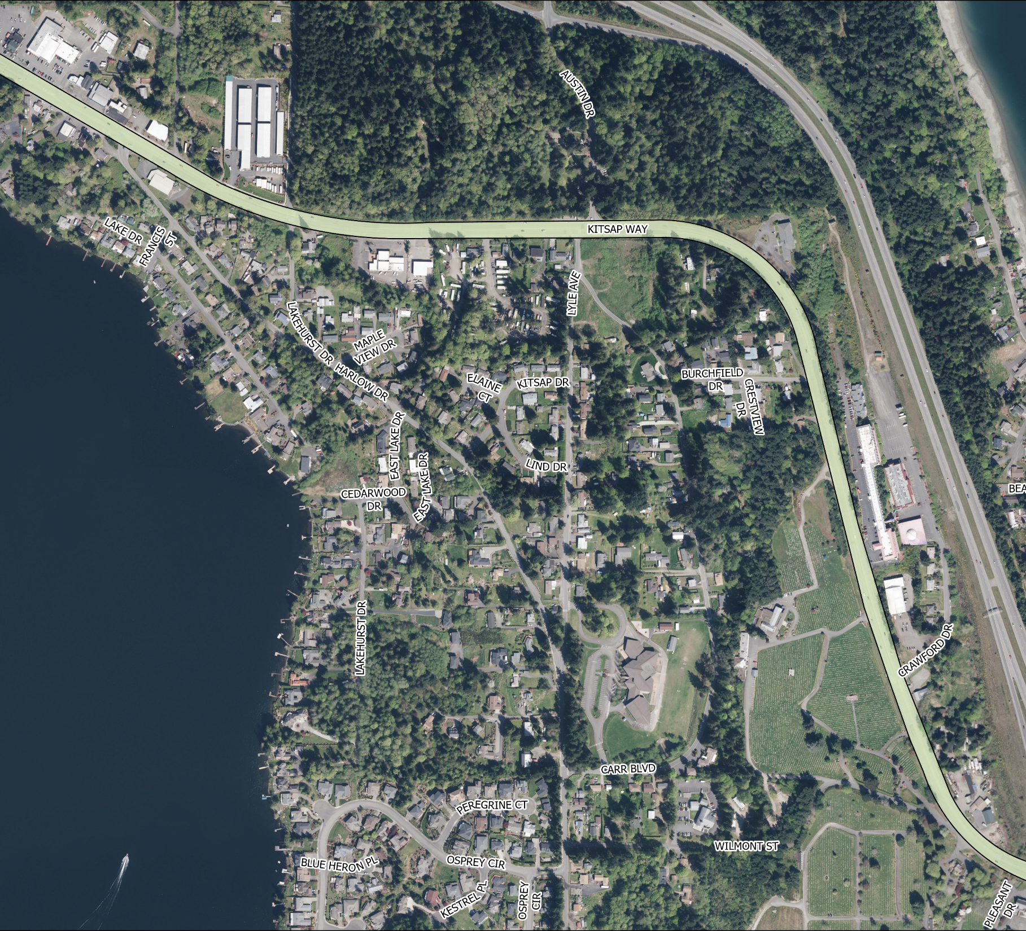
Project Details
Planning Study
Connection to regional centers Silverdale and Bremerton
Project limits from Northlake Way / Chico / City Limit to State Route 3
Old State Highway 21
Functional Classification = urban minor arterial
Annual Daily Traffic (ADT) = 20,000 vehicles
Poor pavement condition
High vehicle speeds
Lack of bicycle and pedestrian facilities; corridor is a major gap in non motorized network
Proposed project would include complete street reconstruction, separated bike lanes and new ADA compliant sidewalks
Project Cost $606,000; Funding request $524K general STP

Slide 5
Questions

