Slide 1
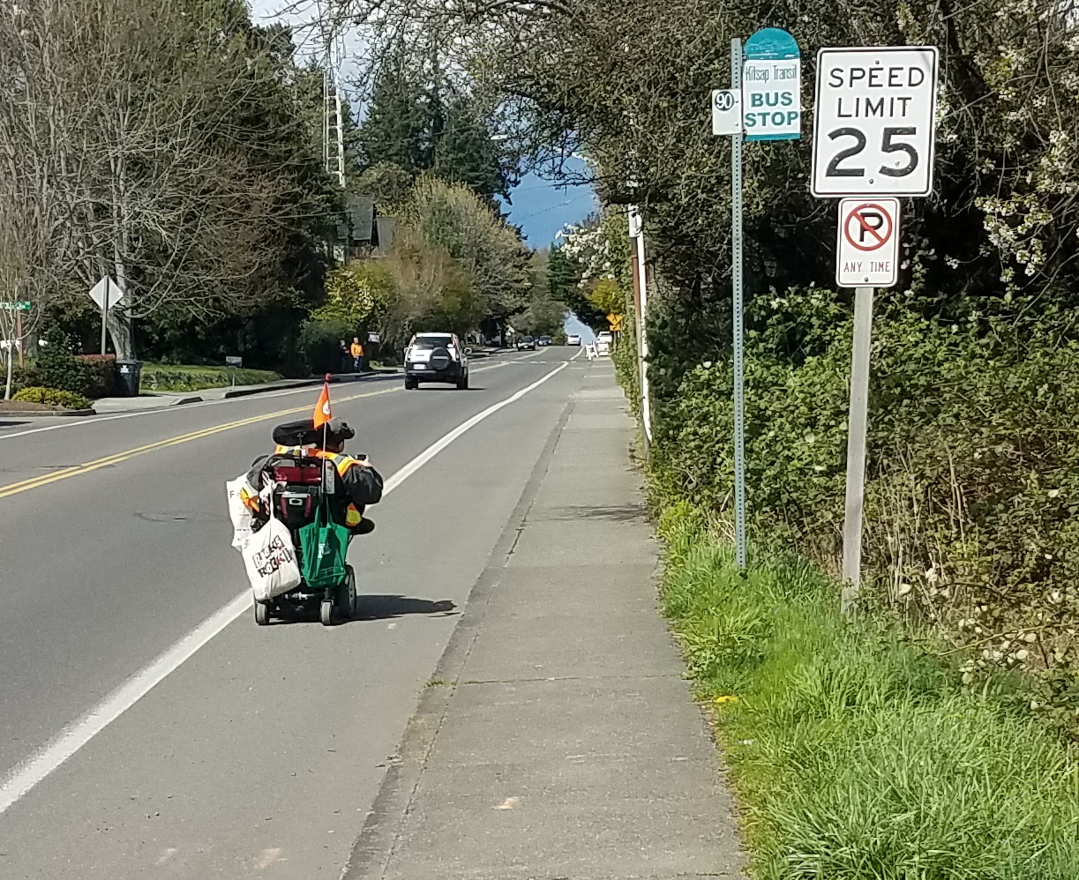
2018 STP County-wide Competition
Madison Avenue Sidewalk Improvements

Slide 2
Schools
Library
Madison Avenue
Winslow Way Commercial Core

Slide 3
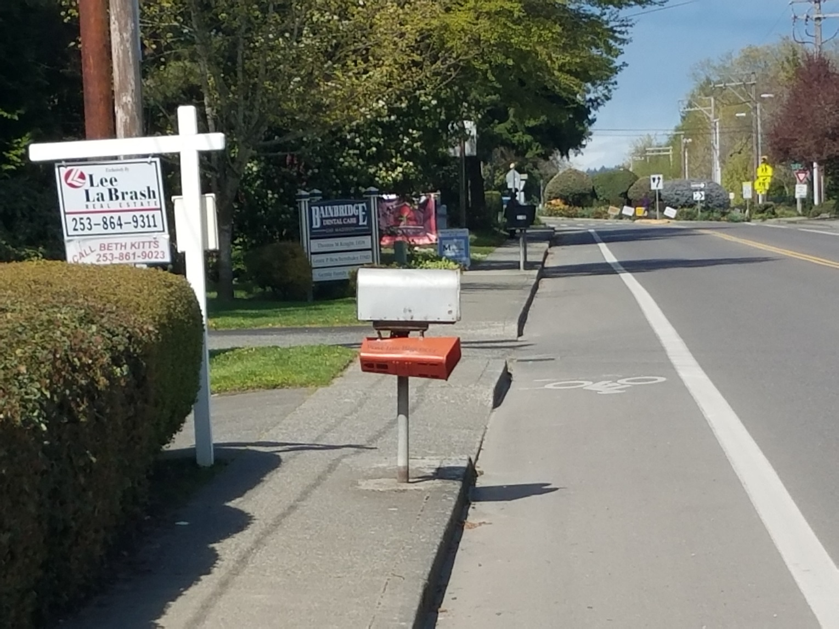
Project Overview
Main N-S connection within Winslow Center to commercial, schools, transit stops, high-density housing areas
Corrects ADA deficiencies
Large assisted living facilities on this street
Significant wheelchair traffic
Increases safety for non-motorized users
Encourages increased non-motorized travel
Improve non-motorized connectivity within Winslow, Center

Slide 4
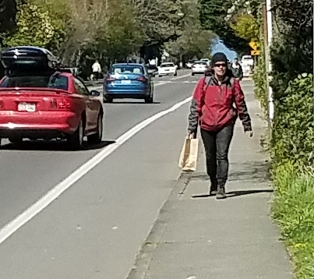
Project (Schedule) Readiness:
Madison Avenue Sidewalk Improvements
No ROW phase required
Funding PE = $301.3K in 2021
STP $270K, City match $31.3K
Funding CN = $1,630.1K in 2022
STP $1,410K, City match $220.1K

