Slide 1
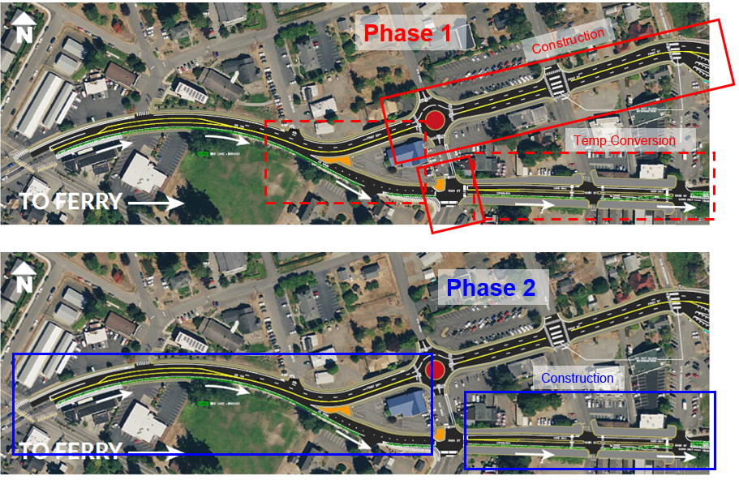
SR 104 Realignment – Kingston
Phase 1 and Phase 2
Phasing and phase cost split TBD.
Re-align SR 104 to move inbound ferry traffic to north couplet (1st St.).
Phase | Funding
PE (underway) | $856,000
ROW (secured funding) | $1,630,000
Construction | STP $7,551,570 Match Toll Tax Credits
Total | $10,037,570
Category: General, NM

Slide 2
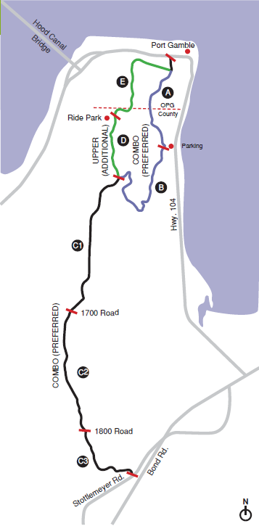
STO – Port Gamble Trail
A, B, & D
Construct Shared Use Path segments A, B, & D (17,927 ft., 3.4 miles) from Port Gamble to top of Ridgeline and “Ride Park”.
Phase | Funding
PE (underway) | $504,481
ROW | $0
Construction | STP $2,660,162 Local $415,170
Total | $3,579,813
Category: General, NM, Rural

Slide 3
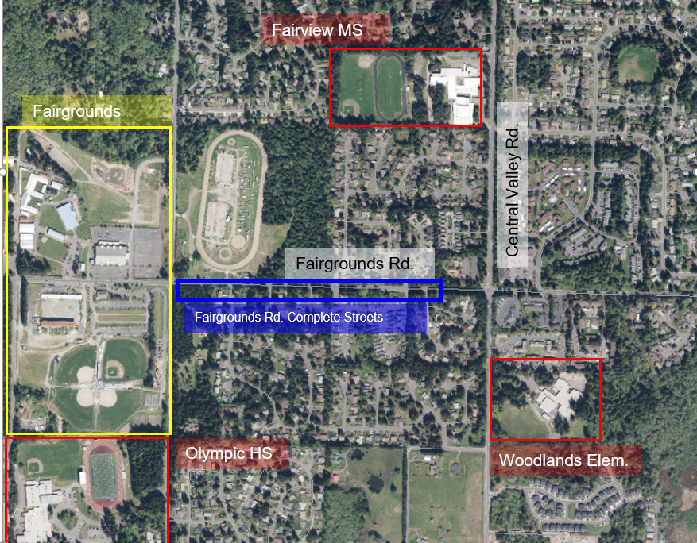
Fairgrounds Road
Complete Streets
Construct sidewalk and bike lane(s) from Woodridge to vicinity Nels Nelson
Phase | Funding
PE (underway) | $250,000
ROW | $200,000
Construction | STP $2,600,000 Local $405,780
Total | $3,455,780
Category: General, NM

Slide 4
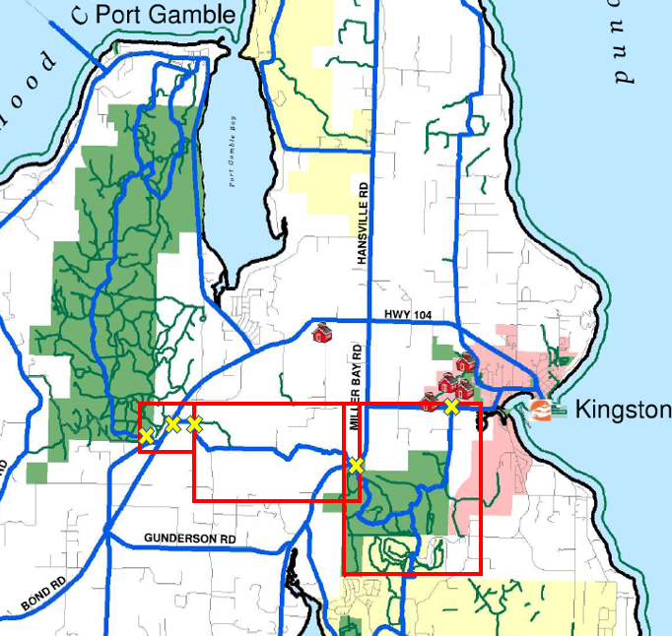
North STO Trail
Planning Study
North Sound to Olympics (STO) Trail Planning Study. Paved, shared-use-path from:
West Kingston Rd. through North Kitsap Heritage Park,
“Divide Property” to Port Gamble Road , to
The southern trailhead of the Port Gamble Trail on Stottlemeyer Road.
Phase | Funding
Planning | STP $350,000 Local $55,000
Total | $405,000
Category: General, NM, Rural

Slide 5
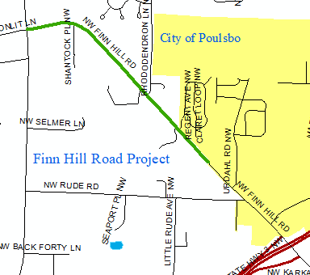
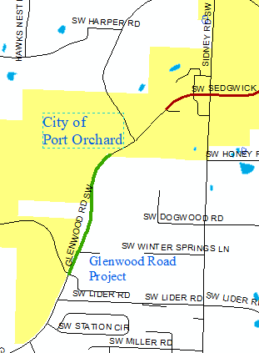
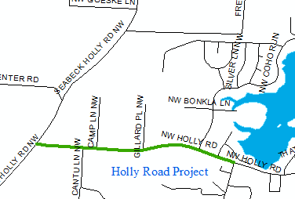
County Paver Bundle
Pavement overlays:
Finn Hill Rd. - Clear Creek to Poulsbo (1 mile)
Glenwood Rd. - Lake Flora to Port Orchard (.97 miles)
Holly Rd. -Seabeck-Holly to Tahuyeh Lake Rd. (.94 miles).
Phase | Funding
PE | $0
ROW | $0
Construction | STP $1,001,873 Local $156,362
Total | $1,158,235
Category: Preservation, Rural

