Slide 1
Noll Corridor North Segment (Langaunet)
City of Poulsbo
COUNTYWIDE
GRANT APPLICATION
March 19, 2020

Slide 2
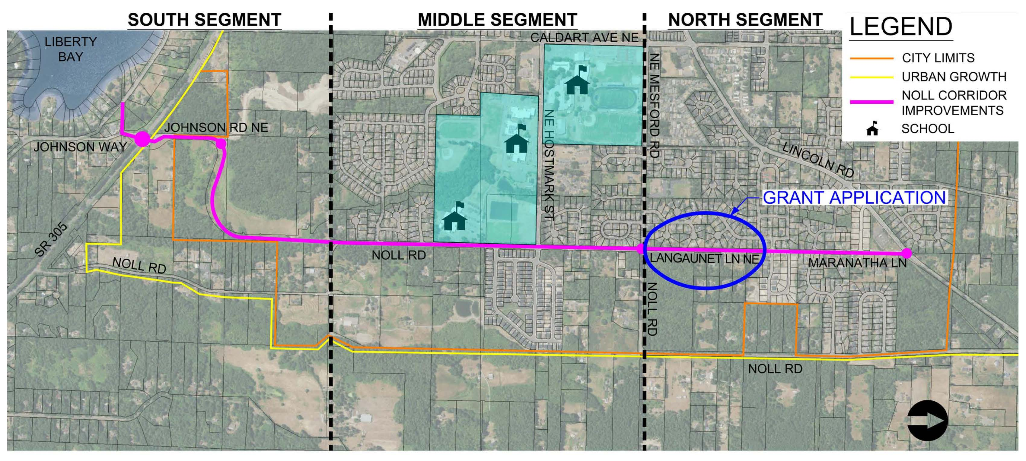
NOLL CORRIDOR IMPROVEMENTS
GRANT APPLICATION
LANGAUNET PHASE

Slide 3
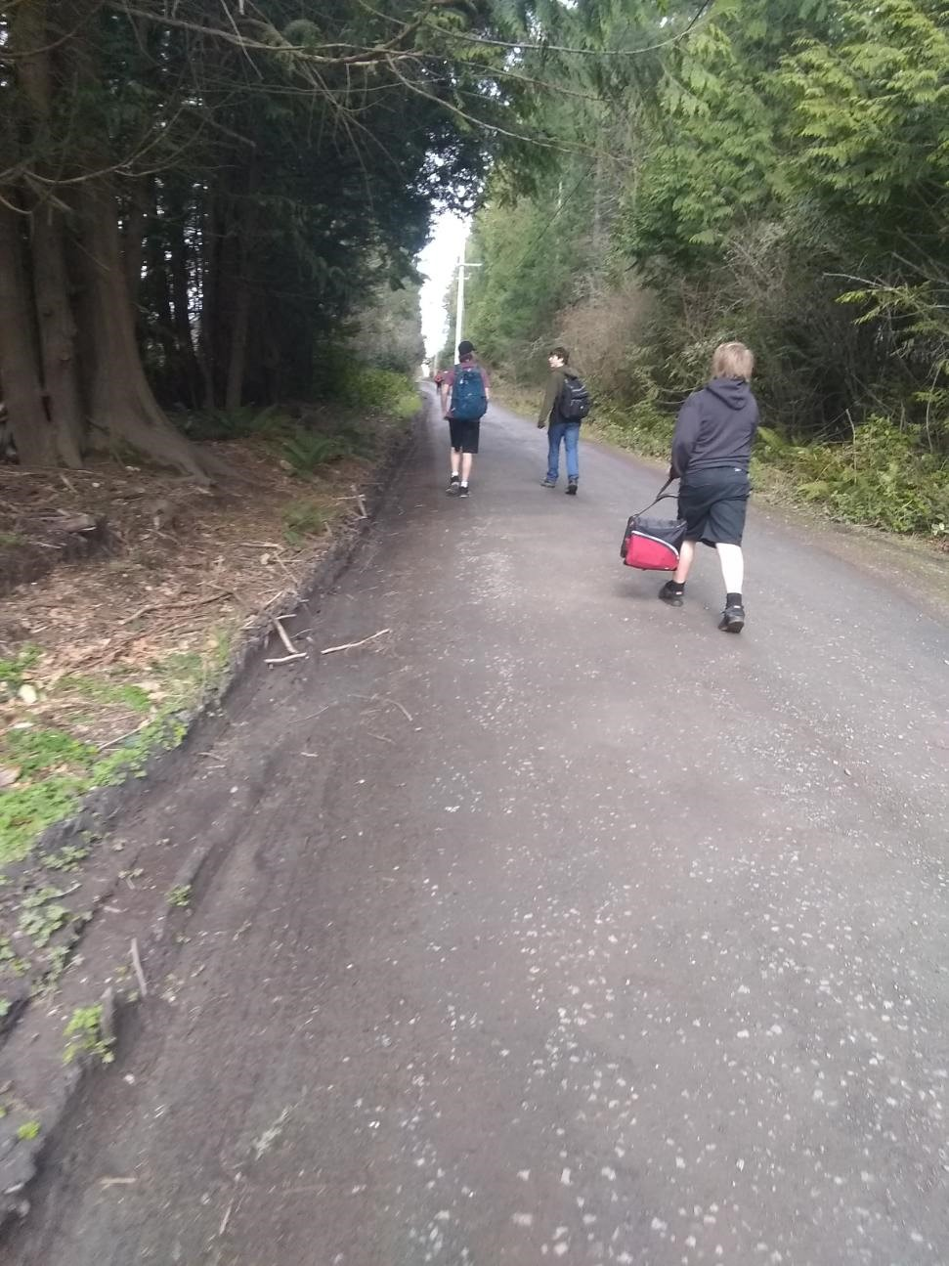
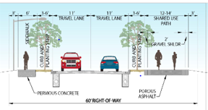
ROADWAY IMPROVEMENTS
Before Project
EXISTING ROADWAY
So
PROPOSED SECTION
Notes:
The plans general strategies reflect a variety of needs. City has evaluated many of these needs over the past 5-10 years, but has not integrated the evaluations into a cohesive picture that involves the community and elected officials, and programs specific projects that address the needs. That is what this project will do.

Slide 4
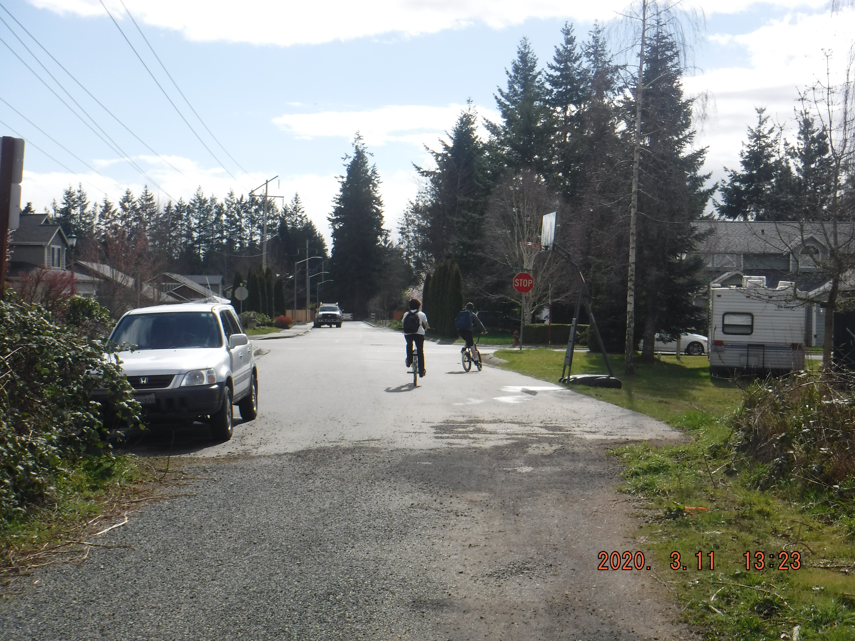
LANGAUNET PHASE – BENEFITS
Safe Route to Schools
Pedestrian connection to three neighborhood schools.
Regionally significant alternate route to SR305
Poulsbo, Bainbridge, SR305, Kingston
Intersection of Mesford, Noll and Langaunet
Notes:
The plans general strategies reflect a variety of needs. City has evaluated many of these needs over the past 5-10 years, but has not integrated the evaluations into a cohesive picture that involves the community and elected officials, and programs specific projects that address the needs. That is what this project will do.

Slide 5
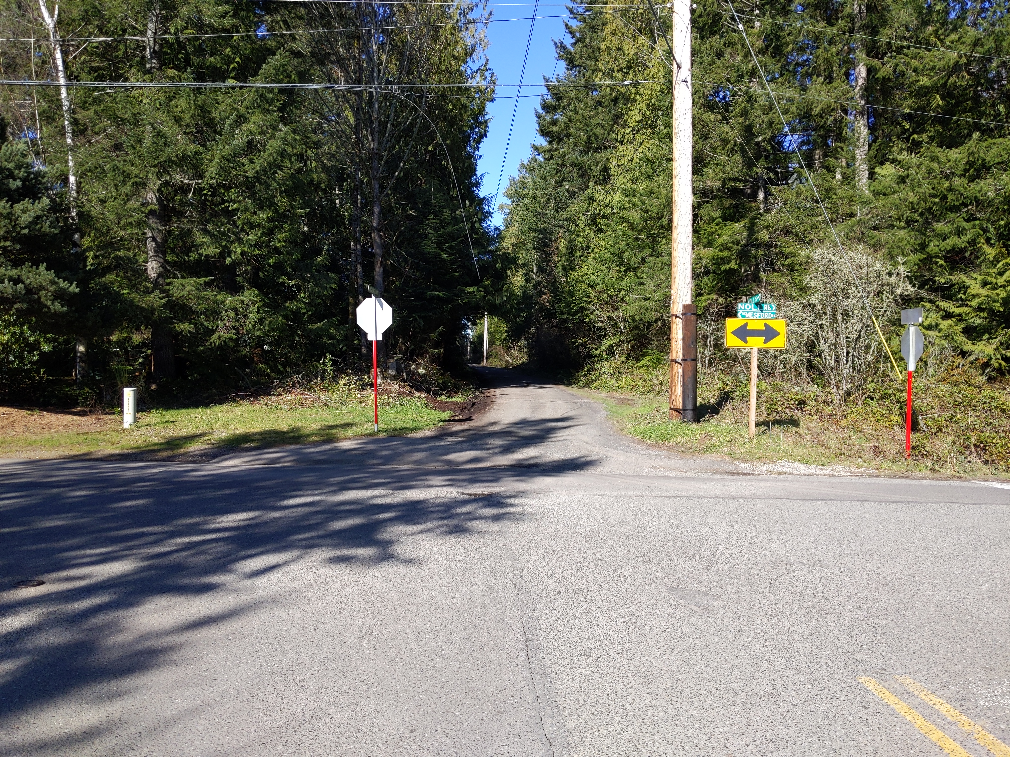
LANGAUNET PHASE – FUNDING
1,800 LF Roadway Improvements
Construction Cost - $2.7M
Grant $ 2.35M
City $ 350K (Traffic Impact Fees)
2024 Construction
Additional Grant Applications will include
TIB and Safe Route to Schools
Intersection of Mesford, Noll and Langaunet
Notes:
The plans general strategies reflect a variety of needs. City has evaluated many of these needs over the past 5-10 years, but has not integrated the evaluations into a cohesive picture that involves the community and elected officials, and programs specific projects that address the needs. That is what this project will do.

Slide 6
QUESTIONS
THANK YOU!

