Slide 1
Washington State Ferries
Draft 2040 Long Range Plan
Kitsap Regional Coordinating Council
Ray Deardorf, WSF Senior Planning Manager
September 20, 2018

Slide 2
Agenda
Long-range plan timeline
Review Draft Plan elements
  Reliable service
  Customer experience
  Manage growth
  Sustainability and resilience
  Implementation, investments and financial outlook
Discuss fall community engagement plan
Next steps

Slide 3
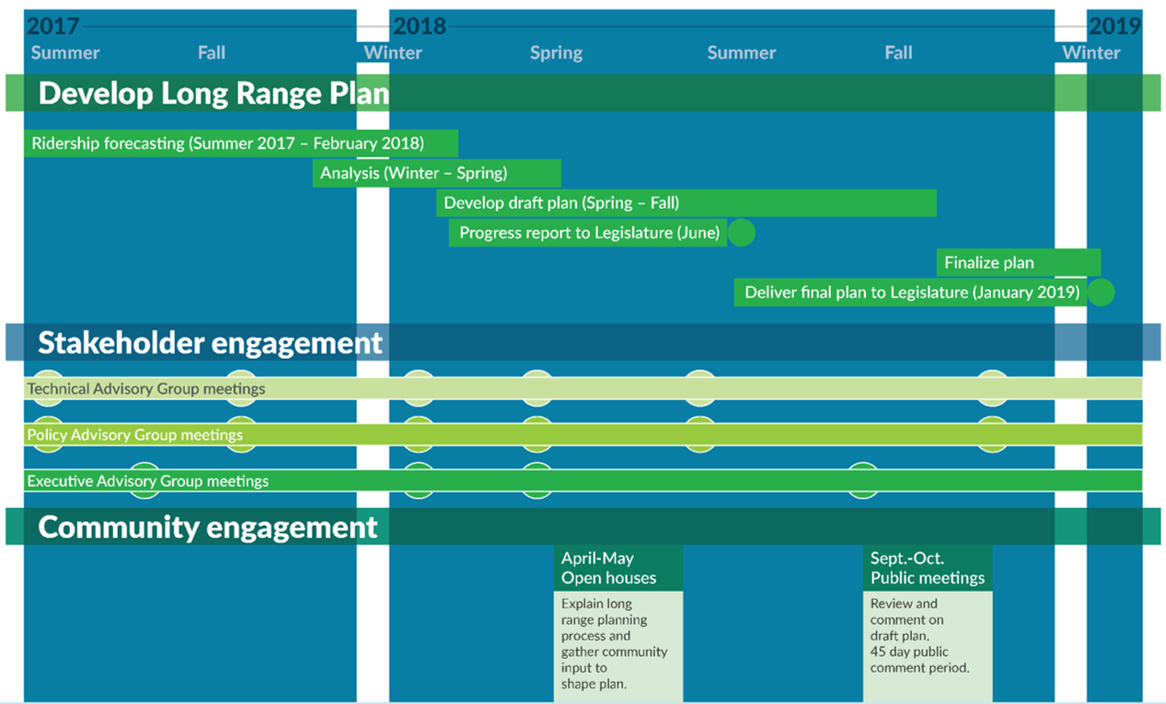
Timeline
Notes:
Discuss Advisory Groups – EAG, PAG, TAG

Slide 4
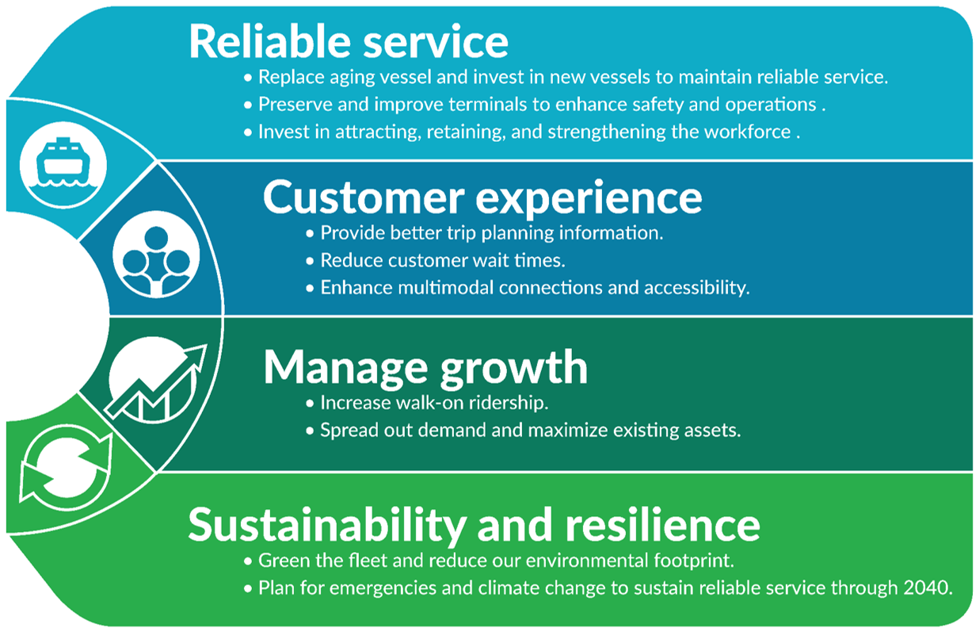
Draft Plan
Notes:
The draft plan is organized around several key themes:
Stabilize the fleet to maintain reliable service.
We will present our draft proposal for new vessels to replace aging vessels and maintain our fleet through 2040.
Customer Experience
Manage growth
Sustainability and resilience

Slide 5
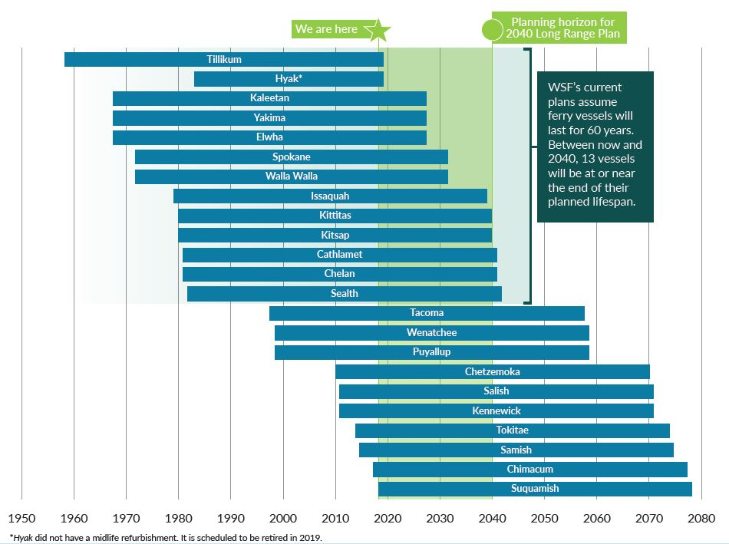
Reliable service— Replace aging vessels to maintain reliable service.
Notes:
This slide acquired the nickname, “The Scary Chart” at our first round of public outreach last spring.

Slide 6
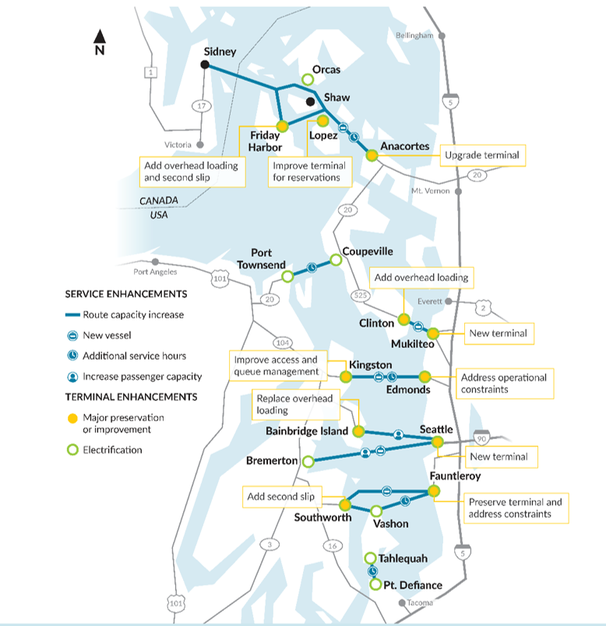
Service and terminal enhancements by 2040
Notes:
This map shows all of the service and terminal enhancements planned by 2040
All routes will benefit from additional service, terminal preservation or improvement, capacity increases, or new vessels
All terminals would be electrified to serve their corresponding vessel.
This investment will bring fuel consumption and therefore costs and carbon emissions down tremendously.
Terminal improvements with the goal of route efficiency by increasing throughput of customers and minimizing dwell time.
Additional service hours:
Coupeville/Port Townsend
Edmonds/Kingston
Fauntleroy/Vashon
San Juan Islands
Point Defiance/Tahlequah
Increase passenger capacity:
- Seattle/Bainbridge and Seattle/Bremerton
New vessels:
San Juan Islands
Edmonds/Kingston
Seattle/Bremerton
Fauntleroy/Southworth

Slide 7
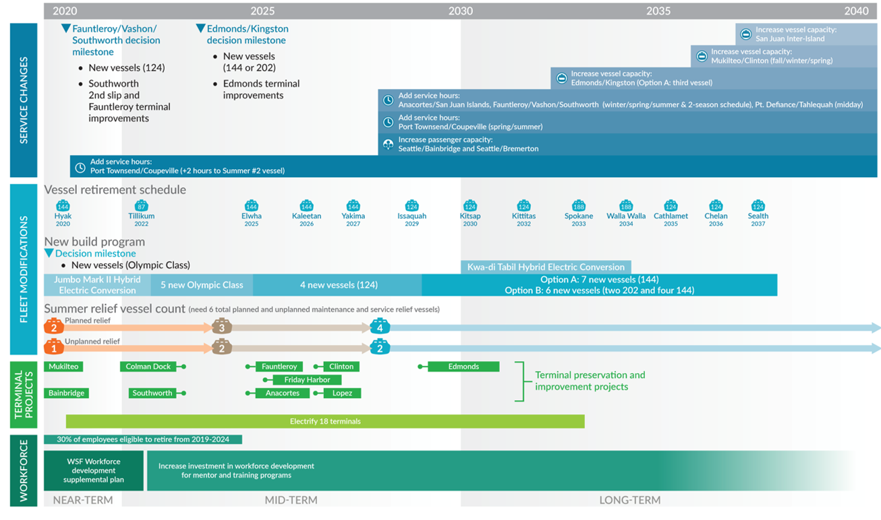
Draft plan implementation timeline
Notes:
The whole plan, on one page!
Building the fleet to 26 vessels by 2040.
5 new Olympics right away, 4 new 124s and 7 new 144s
Building the reserve fleet to allow for service reliability and allow fleet to receive the required maintenance
By 2040, all new vessels would be build with hybrid or all-electric propulsion systems and remaining vessels would be electrified at some level.
All terminals would be electrified to serve their corresponding vessel.
This investment will bring fuel consumption and therefore costs and carbon emissions down tremendously.
Terminal improvements with the goal of route efficiency by increasing throughput of customers and minimizing dwell time.
Growth was looked at holistically—managed through terminal and vessel infrastructure, communication, information technology and other adaptive management strategies, with future ridership demand analyzed and guided by local agency plans and policies to manage that growth.

Slide 8
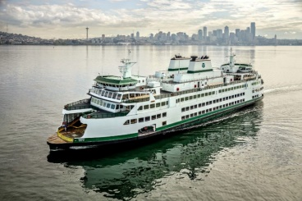
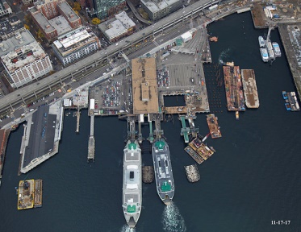
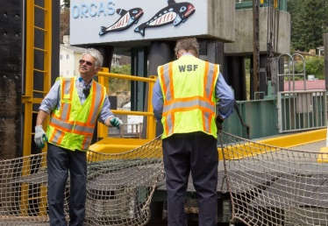
Reliable service—Stabilize the system to maintain reliable service through 2040.
Draft Plan recommendations:
Stabilize the fleet by building new vessels.
Maintain and improve terminal efficiency.
Develop workforce.
Notes:
3 elements to reliable service
Background:
Aging fleet, high utilization
Lack of funding
Prioritizing service
over maintenance
Lack of relief vessels to perform
required maintenance
Stabilize the fleet
Build five new Olympic Class vessel(s) immediately using existing contract—followed by—long-term, comprehensive replacement program
Increase fleet size to allow for maintenance needs
Review policies regarding vessel lifespan, contracting restrictions and vessel procurement processes.
Maintain and improve terminal efficiency
Investments to improve operational efficiencies
Develop Workforce
Develop, invest and improve strategies to attract, retain and develop talent.
We are recommending several actions to stabilize the fleet, including: Building five new Olympic Class vessel(s) immediately, in service by 2022/2023
Stabilize the fleet
Build five new Olympic Class vessel(s) immediately using existing contract—followed by—long-term, comprehensive replacement program
Increase fleet size to allow for maintenance needs
Review policies regarding vessel lifespan, contracting restrictions and vessel procurement processes.
Maintain and improve terminal efficiency
Investments to improve operational efficiencies
Develop Workforce
Develop, invest and improve strategies to attract, retain and develop talent.
We also recommend reviewing policies:
Review vessel useful life within Life Cycle Cost Models
Review contracting restrictions on shipyard contracts to streamline building process
Implement public education and outreach campaign on the state of the ferry system and its importance to economy

Slide 9
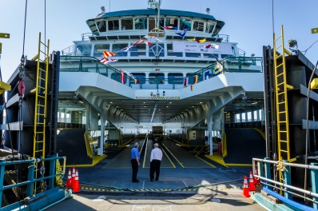
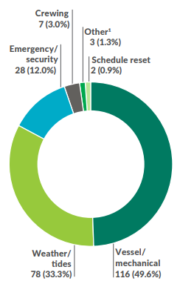
Reliable service—Replace aging vessels to maintain reliable service.
Draft Plan recommendations:
Near-term:
  Build five new vessels, bolster relief fleet, replace Super class
Long-term:
  Comprehensive construction program – replace Issaquah and Jumbo Mark I class.
Review policies:
  Vessel lifespan
  Contracting restrictions
  Vessel procurement processes
  Performance measures
Top reasons for service cancellation:
Notes:
Enhance technology, cost efficiencies, redundancy, flexibility and reduce emissions through comprehensive construction program
Conflict of priorities and resources: trip reliability vs out of service time and
This is an increase from 8 weeks currently, which is not able to be utilized due to priority of service.
Cost efficiencies through: similar vessel platform, electrification, workforce efficiencies (crew size and training)
Add performance measure regarding vessel reliability.

Slide 10
Reliable service—Invest in new vessels to maintain reliable service.
Draft Plan recommendations:
Build new vessels to provide reliable service during scheduled maintenance and allow for needed maintenance time.
Plan more time for maintenance.
Enhance service when relief fleet is available.
 | Fleet size | Planned annual maintenance weeks per vessel
Existing policy | 23* | 8
Long Range Plan recommendation | 26 | 12
*Fleet temporarily increased to 23 from 22 after Suquamish added and before Hyak retires.
Notes:
Plan 12 weeks to maintain vessels instead of the current 8 weeks.
Conflict of priorities and resources: trip reliability vs out of service time and
This is an increase from 8 weeks currently, which is not able to be utilized due to priority of service.
Cost efficiencies through: similar vessel platform, electrification, workforce efficiencies (crew size and training)
Add performance measure regarding vessel reliability.

Slide 11
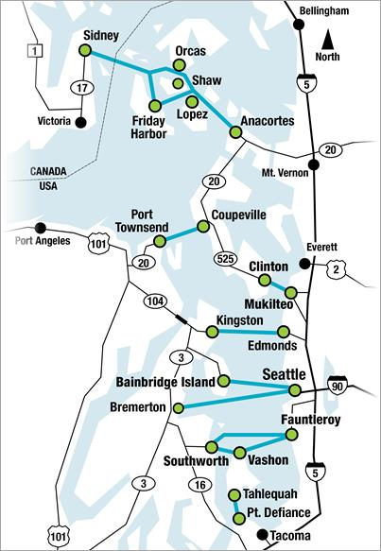
Reliable service—Preserve and improve terminals
Draft Plan recommendations:
Improve dwell time and reduce operational conflicts.
Enhance multimodal connections.
Add electric vessel charging and infrastructure.
Establish dwell time performance measures.
Notes:
Background:
Aging terminals and infrastructure
Not built to withstand earthquakes
Increased congestion and ridership growth

Slide 12
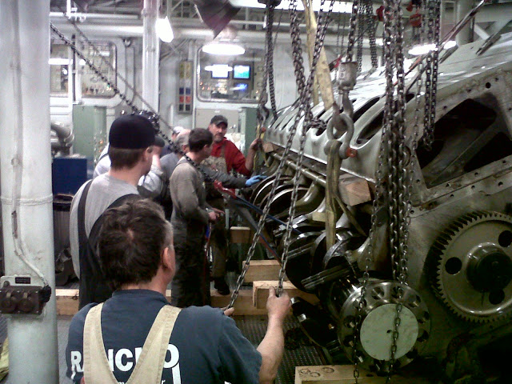
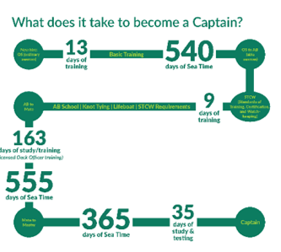
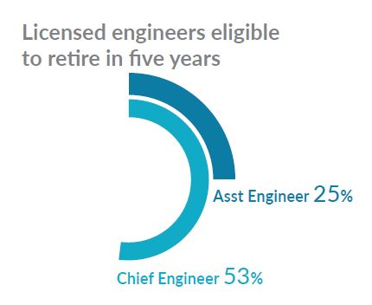
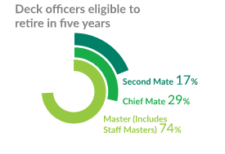

Reliable service—Invest in attracting, retaining, and developing workforce.
Draft Plan recommendations:
  Develop program to retain, recruit, train, and mentor staff.
  Update salary survey to reflect market conditions.
Notes:
Background:
Aging workforce: 30 percent of workforce eligible to retire within five years
Specialized positions require high level skill and licensing
Economic boom contributes to wage pressure and high turnover
Lack of available trained staff costs WSF, increases overtime
Earning a master’s license requires years of training, testing and preparation including sixteen roundtrips on each of WSF’s ten routes and successfully drawing pilotage maps during testing. Most of the required work must be accomplished on an employee’s own time.
Nearly ten years ago WSF eliminated their mate training program. Before the program was eliminated on average seven employees a year were receiving mate’s licenses. In the six years after the program was eliminated only sixteen new mates, or on average less than three per year were qualified contributing to the current mate shortage. The MMP estimates WSF should be qualifying twelve new mates a year to meet current and projected needs.
Going into the summer season this year (2018) there are four existing open mate positions. This means those mate shifts will be filled on overtime and additional dispatch time will be incurred to cover the unfilled positions. Compounding the shortage is the announced retirement of two masters, creating two new mate openings through promotion; WSF will operate down six mate positions this summer.
70% vessel start up in Kitsap County
More and more hires coming out of King County
Development of WSF Workforce Development Supplemental Plan
Establish and invest in recruitment, training, and mentor programs for all positions
Develop strategies to encourage qualified, experienced workers to stay in the workforce while attracting and retaining younger workforce
Update salary survey data regularly for wage adjustments to reflect market conditions

Slide 13
Customer experience—Use technology to enhance customer experience.
Draft Plan recommendations:
Give customers better trip planning information.
  Ticketing and reservation system.
  Customer alerts.
  Accurate terminal conditions and wait times.
  Terminal wayfinding and real-time information.
  Real-time parking information.
Reduce wait times.
  Improve terminal operations.
  Increase service and maintenance relief vessels.
  Upgrade technology.
Notes:
Ray
Background
WSF relies on manual processes; need for integrated systems and better data management
We need accurate and reliable passenger counting; customer information incomplete
Communications infrastructure and electronic fare system needs updating
Provide the information that customers need for a reliable trip
Evolution of ticketing and reservation system
Customer alerts and notification system
Accurate terminal conditions and wait times
Terminal wayfinding and real-time information
Real-time parking information
Improve on-time performance through 2040 investment strategies
Terminal improvements to improve processing and wait times
Increased service and maintenance relief vessels
Back office software upgrades

Slide 14
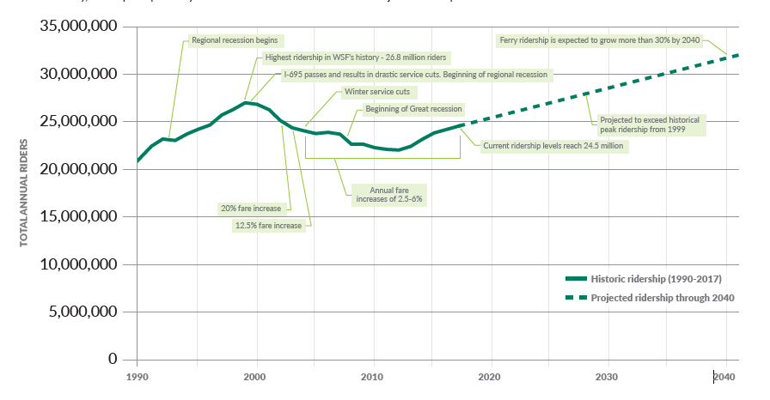
Manage growth — Ridership demand

Slide 15
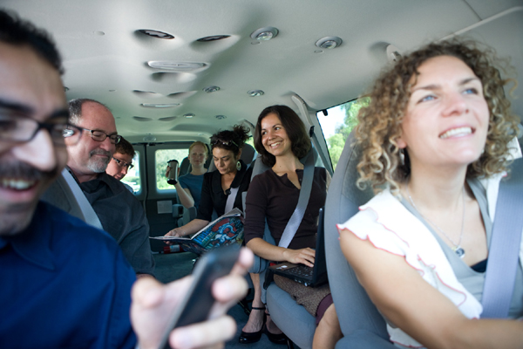
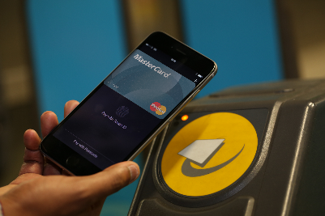
Manage growth—Invest in technology and adjust schedules to spread demand and encourage walk-on riders.
Draft Plan recommendations:
Promote walking and biking to improve efficiency.
Use technology to measure vehicle wait time.
Evaluate expanding reservations.
Further consider pricing demand management.
Policy:
  Add passenger level of service.
  Measure space available for reservations.
  Add vehicle wait time performance measure.
Notes:
Background:
Ferry ridership is expected to increase 30 percent by 2040
Vessel replacement and terminal projects present an opportunity for a more efficient operation and increase in system capacity.
WSF has limited financial resources to increase capacity
Revise level of service standards to prioritize non-motorized passengers and inform future demand management.
Add level of service criterial for passengers that meets peak period demand.
On routes with reservations, measure space available for reservations instead of total vessel capacity
Develop methodology for tracking and managing vehicle wait times through the addition of wait time performance criteria.
Promote mode shift and improve operational efficiencies through implementation of adaptive management strategies

Slide 16
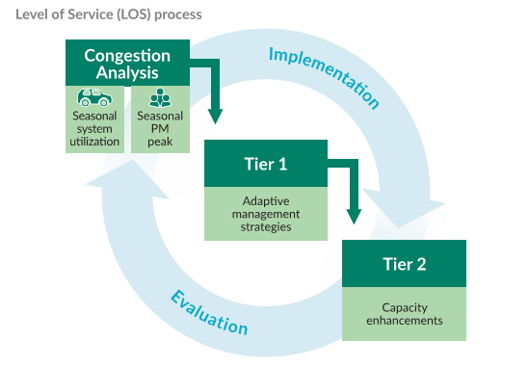
Manage growth - LOS standards
Notes:
Level of service standards are important to understanding service customers are receiving and determining when to add service or explore strategies to manage demand.
Our current level of service are based on the percent of sailings filled to vehicle capacity, with varying standards for January (off-peak season), May (mid-range), and August (peak season).
When vehicle capacity is full on 25%-35% of sailings in Jan, May, August, we reach Tier 1 and explore strategies for easing congestion (operational, scheduling, fares, reservations)
When vehicle capacity is full on 50%-85% of sailings in these months, we reach Tier 2 and need to add vehicle capacity with larger vessels or additional sailings.
The draft plan proposes adding a passenger level of service, based on typical PM peak westbound sailings. Essentially, if seated capacity is reached it results in a Tier 1 response to try to spread demand. Exceeding the life raft capacity of the vessel triggers an increase in passenger capacity on the vessels service the route.

Slide 17
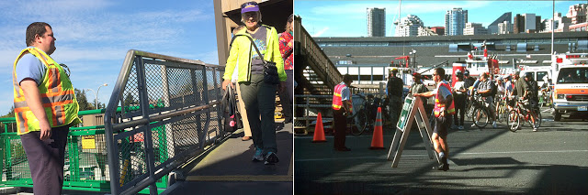
Manage growth—Adjust schedules and vessel capacity to manage demand.
Draft Plan recommendations:
Increase service hours.
  Restore service hours.
  Adopt two-season schedule.
  Consider options for Central Sound routes.
Strategically increase vessel capacity.

Slide 18
Manage growth—Adjust schedules and vessel capacity to manage demand.
*Includes Option A for Edmonds/Kingston
Notes:
Add capacity through increased service hours
Restore service hours
Move towards a two-season schedule
Kitsap capacity increase
Vessel enhancements to increase carrying capacity
Modifying existing vessels
leveraging replacement vessels

Slide 19
Manage growth—Increase passenger capacity to encourage walking and biking.
Draft Plan recommendations:
Increase passenger capacity on Bremerton and Bainbridge routes.
Notes:
To meet PM peak—this happens ~2028 through addition of life rafts, crew and potential cabin enclosures to meet passenger demand.

Slide 20
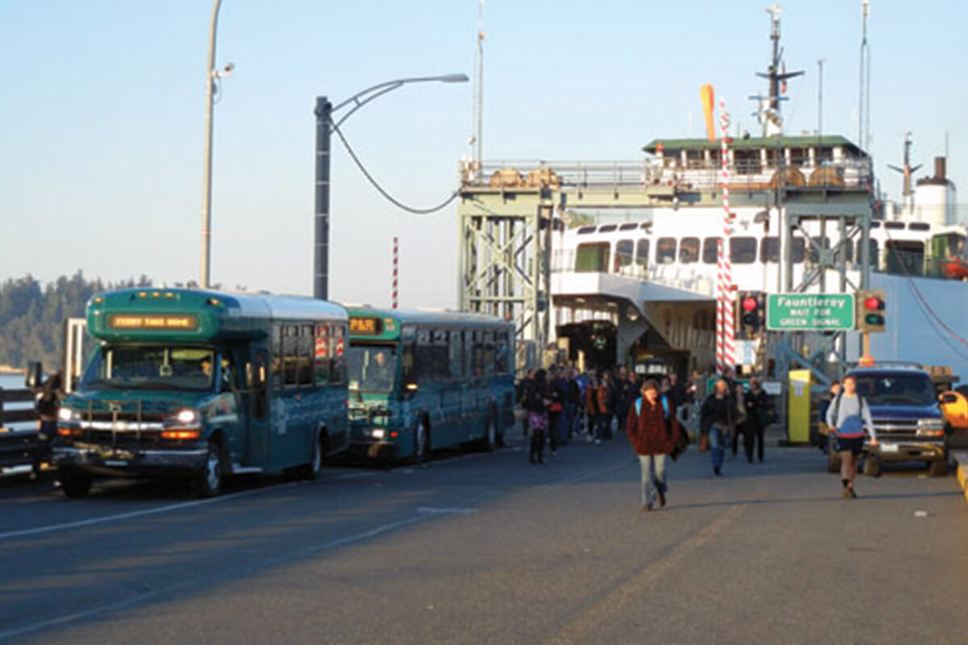
Manage growth—Operational Strategies to spread demand and encourage walk-on ridership.
Draft Plan recommendations:
  Expand reservations.
  Consider pricing and fare structure.
  Partner with transit providers to improve multimodal connections.
  Give customers real-time trip planning information.
  Improve fare collection.
Notes:
Strategies have two different goals—spread demand and encourage mode shift. In other ways in the plan prioritizing walk and bike on passengers.
Draft Plan recommendations:
Strategies to spread demand
Evaluate expansion of reservations on a case-by-case basis
Further consider the role of pricing in demand management
Support customers in planning and taking multimodal trips coordinated with other mobility service providers (transit, TNCs, etc.)
Strategies to promote mode-shift
Provide the information that customers need for a reliable trip
Improve fare collection
Evaluate fare structure and pricing
Optimize Fare Collection
Reduced fare transaction time
ORCA card replacement 2021
Good To Go!
Automated vehicle length/width detector
Vehicle Reservations Study
Lopez, Shaw, Central/North Sound
Different levels of reservations (weekend)
Fare Structure and Pricing
“Opposite peak” for recreational traffic
Reduce or eliminate passenger fares
Complexity versus fare simplification

Slide 21
Options for Edmonds/Kingston route—Relieve congestion
Option A: Replace two large vessels with a three mid-sized vessels.
Option B: Continue operating two large vessels.
Option | Number of vessels in service | Vessel type | Per vessel vehicle capacity | Per vessel passenger capacity | Sailing frequency
A | 3 | Medium | 144 | 750 to 1200 | Every 30 min
B | 2 | Large | 202 | 1800 / 2000 | ~Every 45-60 min
Notes:
Ray
Key issues:
Vehicle congestion on all Kitsap routes
Constraints and congestion at Agate Pass Bridge

Slide 22
Options for Edmonds/Kingston route
Draft Plan options:
  Replace two (2) large-vessel operation with a three (3) mid-sized vessel operation
  Maintain existing two (2) large-vessel operation
Notes:
Mid-sized=144 car with varying pax capacities of 750-1200

Slide 23
Options for Edmonds/Kingston
Assessment:
Congestion relief:
  Additional capacity at Edmonds/Kingston.
  Could divert some growth from other routes.
Preliminary net annual operating cost increase of (~$2.6 mil*).
Additional vessel capital costs.
System resiliency.
* Shown in 2019 constant dollars
Notes:
Edmonds Kingston
Three mid sized vessel option at Ed King adds about $4.6 M in operating but increases revenue by about $2M
Replacing two large vessel is expected to cost about $390 M compared to about $450 for three mid sized vessels

Slide 24
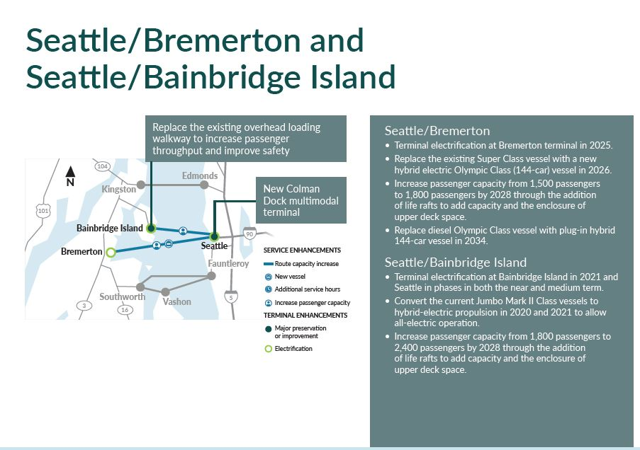

Slide 25
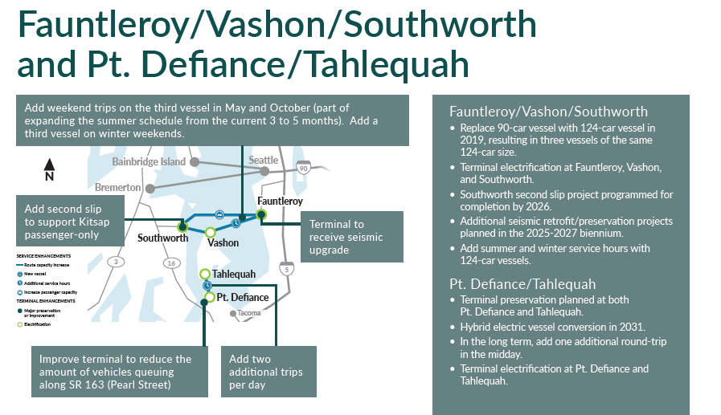

Slide 26
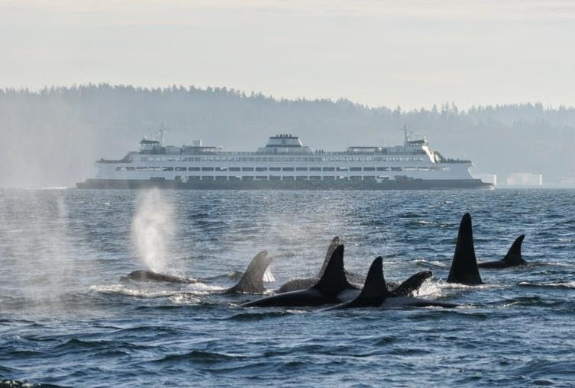
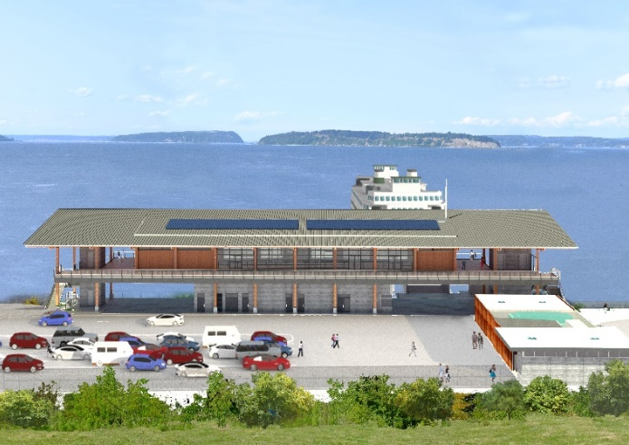
Sustainability and resilience—Green the fleet and reduce our environmental footprint
Draft Plan recommendations:
Green the fleet.
  Reduce fuel consumption.
  Electrify fleet.
  Quiet ferries to reduce impact to Orca whales.
Promote walk-on ridership.
Improve operational efficiency.
  Reduce idle time for queued vehicles.
  Improve buildings’ energy efficiency.
Notes:
Sustainability can be defined in many ways—we looked at how sustainable planning was integrated into every theme of the LRP.
Draft Plan strategies:
Adaptive management
Operational efficiencies
Reduce idle time for queued vehicles
Improve facilities’ energy efficiency
Vessel design and programming
Reduce fuel consumption and electrify fleet
Transition to zero-carbon emission fleet
Quiet ferries to reduce impact to Orca whales
Performance measures
Add GHG emissions as a performance metric
Further sustainability recommendations:
Internal organizational strategy—integrated decision making—Culture Change
Baseline and tracking with central reporting
Seek National and International partnerships
WSF joins GREEN MARINE
The work around this subject is fast paced and every changing with technologies. Just during this planning work WSF has joined Green Marine.
Green Marine:
Green Marine is an environmental certification program for the North American marine industry.
It is a voluntary, transparent and inclusive initiative that addresses key environmental issues through its 12 performance indicators. Participants are shipowners, ports, terminals, Seaway corporations and shipyards. The cornerstone of the Green Marine initiative is its far-reaching environmental program, which makes it possible for any marine company operating in Canada or the U.S. to reduce its environmental footprint by undertaking concrete and measurable actions.
To receive their certification, participants must benchmark their annual environmental performance through the program’s exhaustive self-evaluation guides, have their results verified by an accredited external verifier and agree to publication of their individual results.

Slide 27
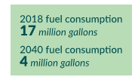
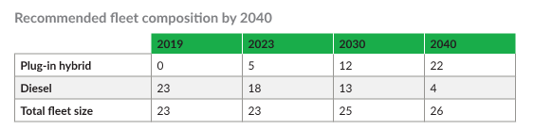
Projected CO2 emissions

Slide 28
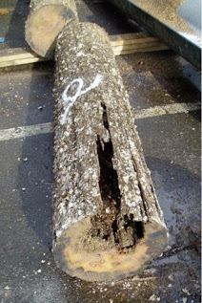
Resilient system—Plan for emergencies and climate change to sustain reliable service through 2040
Draft plan recommendations:
Plan for earthquakes and long term rising sea level.
  Establish key routes for repair.
  Identify and prioritize seismic upgrades.
  Develop emergency response plan.
  Explore alternative landing sites and loading methods.
  Identify fuel supplier emergency access.
  Increase fleet size for emergency relief.
  Assess terminal elevation needs.
  Evaluate design standards.
Identify potential partners and funding sources.
Notes:
Background:
Limited vessels and crew for emergency events
Fuel and shipyard availability
Terminal conditions and rising sea level
Recommendations: so much of this work is underway and changing every week during the planning period. Initial recommendations around emergency response and asset planning have already been explored or implemented.
Sea level rise is also changing—terminal design manual ebing updated currently to reflect new science and projections.
Draft plan recommendations:
Plan for “abrupt” (i.e. seismic) and “developing” (i.e sea-level rise) events
Identify potential partners and funding sources
“Abrupt”:
Establish “lifeline” routes for repair
Identify and prioritize seismic upgrades
Develop emergency response plan
Explore alternative landing sites and
temporary loading methods
Identify fuel supplier emergency access
Increase fleet size for redundancy
“Developing”
Develop climate impact assessment for terminal elevations for all critical equipment
Evaluate design standards to ensure resiliency

Slide 29
Investment and implementation— Plan for a safe, reliable, sustainable, and integrated system.
Near term (0-2 years)—Stabilizing the system
Medium term (3-7 years)—Building the infrastructure
Long term (8-20 years)—Responding to growth
Capital costs
  Vessels
  Terminals
  Technology
Operating costs
  Labor increases
  Fuel (Energy) decreases
  Other

Slide 30
Investment and implementation— Draft capital costs (in millions)
Vessels:
16 New vessels (hybrid-electric).
6 Existing vessel conversions.
Terminals:
Operational improvements projects.
18 Terminal conversions and utility upgrades for electric charging.
Information technology:
System upgrades and enhancements to support operations.

Slide 31
Investment and implementation—Draft operational costs
Dollars by category and biennium (in millions):

Slide 32
Investment and implementation—Draft operating revenue recovery

Slide 33
Investment and implementation—Draft total plan costs
Capital and operating costs through 2040: $14.2 billion
Dedicated tax revenue and fare collection: $7.5 billion
Capital and operating funding needs through 2040: $6.7 billion
Historically the Legislature has appropriated additional revenues to cover the shortfall between dedicated WSF revenues and WSF operating and capital funding needs.

Slide 34
Investment and implementation—Draft total plan costs (in millions)
Funding Capital Investments:
Funding Operations:

Slide 35
Consistency with other plans
Plans of local jurisdictions were also reviewed to assess:
Potential impacts of planned development near terminals.
Adequacy of transit and non-motorized connections.
The extent to which policies in local plans support ferry service and the multi-modal facilities needed for that service.
The Washington Transportation Plan (WTP) and WSF Long Range Plan have been developed in parallel. The plans emphasize common themes:
Improve system reliability and efficiency
Enhance multi-modal connections
Manage demand
Improve resilience and sustainability

Slide 36
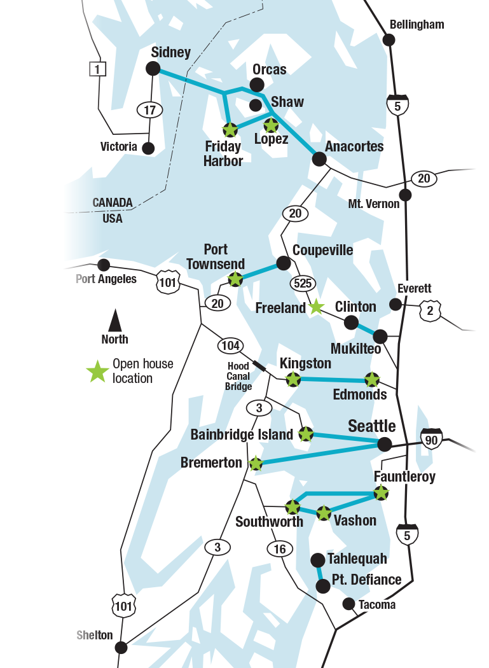
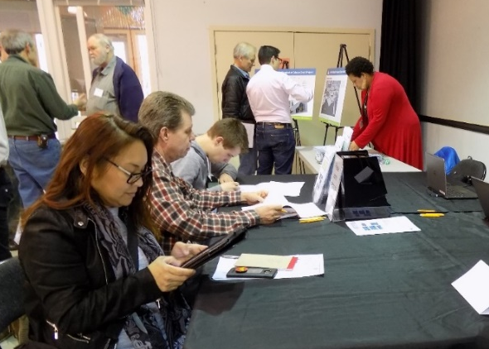
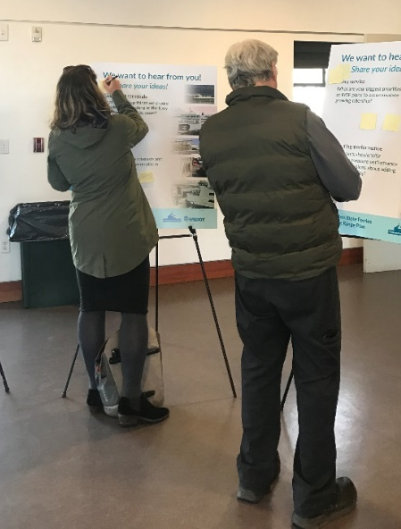
Fall community engagement
11 system-wide open houses
Expanded onboard outreach
Online open house
WSFlongrangeplan.com
Notes:
Hadley
Over the last month, we have met with nine ferry served communities at-in-person open houses and shared all of the same materials at an online open house.
The purpose of this first round of outreach was to introduce the Long Range Plan and gather early input on issues to be addressed in the draft plan.
Thank you to all of you who have participated in the meetings or helped us get the word out!
Our final meeting is tonight in Fauntleroy and the online open house will be open until May 24.

Slide 37
Look ahead

Slide 38
Questions?
Ray Deardorf
Senior Planning Manager
Washington State Ferries
Deardorf@wsdot.wa.gov

